Slide 1
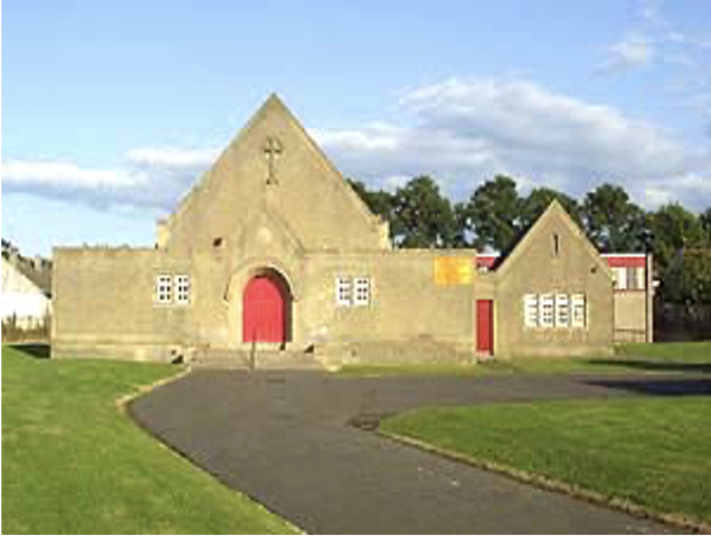
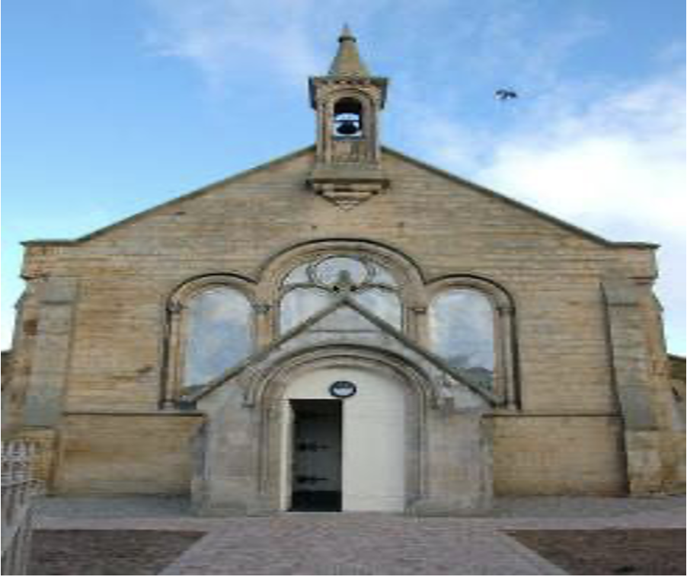
CHANGE OF ADDRESS
If you have moved house recently or are about to move, please fill in the address slip below and either hand it to your elder or post it to Alice Laing, 129 Upper Craigour, Edinburgh EH17 7SE
Thank you.
Name(s): ………………………………………..………………………………
OLD address: ……………………………….……………………..
………………………………………………………………………..
NEW address: ………………………………………..………………………………
................……………………………………………………………
NEW phone number: ……………………………………………………………….……….
Moving date: …………………………………………………..……………………
THE CHRONICLE
AUGUST 2021
SUNDAY SERVICES
TRON KIRK MOREDUN 10.30am
TRON KIRK GILMERTON 5.00pm
MINISTER - REV CAMMY MACKENZIE
This chronicle was delivered by:
…………….………………………………………….……………...
Who can be contacted, if necessary, by telephone on:
………………………………………………………………………..
Tron Kirk Gilmerton and Moredun
Church of Scotland Edinburgh, Registered Charity SC009274
Magazine of the Tron Kirk Gilmerton and Moredun

Slide 2
LETTER FROM OUR MINISTER
Dear friends and Church family
Welcome to our Newsletter and thank you for all your interest and passion for the life worship and witness of Tron Kirk Gilmerton and Moredun. It has been a very quick few months. I want start by saying thank you to everyone for the love I was shown at the loss of my brother Jonny in May and indeed for the love that was expressed when I got Covid in July and then promptly gave it to Dilma and Pedro!!!!
Share and share alike is my Motto…….
Elsewhere in this Newsletter you will read about Fabiano who is training with Tron in his final piece of work before ordination next year into a Parish somewhere by God’s Grace. He is such a great guy and already we have become firm friends and he has begun to make his mark in the life of Tron. Most notably he is creating a 15 week course of studies to help Christians to go deeper into God’s word which begins in a few days’ time at the Hub. Welcome and God bless you Fabiano.
Dear Ivor is still not back among us after wrestling with issues related to his voice which have held him back for several months now and we pray that soon he will be back among us and able to serve once more, which we know he loves to do .He is getting good support from the NHS and is in good spirits. I must thank him again for taking the heavy load of leading daily devotions on facebook last year for several months and starting the daily devotions with such passion and blessing for all who watched and listened.
USEFUL NAMES AND TELEPHONE NUMBERS
Cammy Mackenzie | Minister
Liz Crocker | Deacon
Janet McKenzie | Ordained Local Minister
Ivor Forrest | Pastoral Assistant
Sheila Bertram | Session Clerk
Alice Bertram Muriel Galbraith | Presbytery Elder Safeguarding Coordinator
Margaret Ballantyne | Organist
Alice Laing Denise Forrest | Roll Keeper, Social Convenor, Session Clerk Treasurer
Beth Ferrier Sheena Anderson | Messy Church Leader Chronicle editor Sunday Teas & Life and Work
Pat Wilson Bill & Anna Cormack | Flower Convenor Chronicle Collators
2
15

Slide 3
TR0N NEWS
NEW BABY Congratulations to Muriel Galbraith on the birth of her new baby granddaughter.
BIRTHDAYS
Belated birthday wishes to Allan Crocker who celebrated his 70th birthday in April. Belated birthday wishes to Liz Crocker who celebrated her 60th birthday in May.
ACHIEVEMENTS
Congratulations to Pat Wilson’s grandson Ben on his graduation & marriage to Yukina. He is currently teaching English in Japan. Such a proud moment for his parents who were both born deaf.
IN THE PIPELINE
For some time now we have been trying to set up guitar lessons on a Thursday afternoon at Tron Gilmerton. Hopefully it will start soon once all the safeguarding procedures are in place.
Soul Food is another venture in the pipeline.
VISITOR
Rt.Hons. Lord Wallace (Jim) moderator of the general assembly is preaching at the Tron on Sunday 17th October. Lets have a great turnout.
MESSY IN THE PARK
Takes place on Saturday 4th September at Gracemount (the old church site). If the weather is bad the primary school will be used. Commencing at 2.00pm
THANKS
To our social committee for the very successful afternoon tea, on Thursday 12th August, raising £282 for Christian Aid Work. It was lovely to meet up and catch with friends who we hadn’t seen for ages.
14
14
We have been able to gradually return to a more ‘normal’ worship experience over recent Sundays. We can now sit just a metre apart and sing with our masks on, which whilst not ideal is a great moment for those of us who have been able to get along. Slowly but surely Sunday praise is getting back to more like what we are used too and we are planning to continue to provide online worship every Sunday for the foreseeable future.
Talking of the word future. We are still in the throws of discussions with our cluster group in regard to the Radical Plan to keep the Church going further into the 21st Century. Our cluster includes Liberton Northfield, Liberton Kirk and Gracemount Church. The Kirk session will be sending out further info about this in a few weeks time as discussions continue. One thing I will say is only Liberton Kirk is really guaranteed to still be here by virtue of it being by far the biggest Church. However our proposal involves us offering the national church a saving of 28% over 5 years to help facilitate the future of the life and worship of the four Churches in our South East wedge of Edinburgh. The main thing I have been asking Tron folks to Pray to Father God is
‘THY WILL BE DONE O LORD ON EARTH AS IT IS IN HEAVEN’.
Over the next few months I hope to undertake a period of study leave, which I am in the process of applying for. I will give more details next time but I also want to say that there will be an opportunity to take part in an Alpha Course before the end of the year. If you have never experienced Alpha it is a really great opportunity to learn and grow as a Christian. If you want more details from me please call on 07838912361. One last thing is that if you would like a visit from me please also get in touch.
God bless you all and give you peace.
3

Slide 4
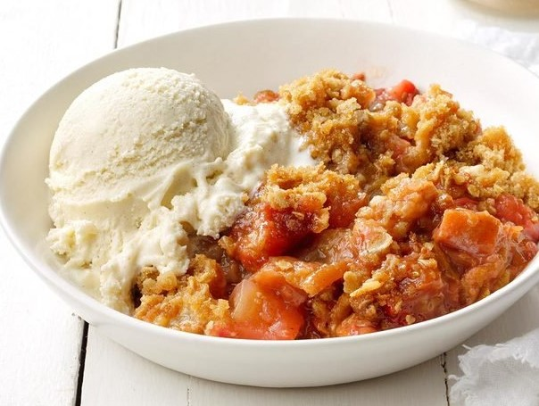
FUNERALS
December 2020 - Agnes Burnett, Ferniehill Drive
January 2021 - Helen Shillington, Ferniehill Drive
January 2021 - Marie Ireland, Moredun Park Street
April 2021 - Nan Inwood, Pine Villa Nursing Home, Loanhead.
Our thoughts and prayers are with the families of the above at their sad loss.
HOME COMMUNION
You may be one of our more elderly or infirm members who are not now able to attend church and also miss out on our Sundays.
If you would like to receive Communion in your own home please contact the minister on 664 7538 or our Session Clerk, Sheila Bertram on 445 2129, or Alice Laing on 621 0635 who will be able to arrange this for you.
LIFE and WORK MAGAZINE
If you would like a copy of the Church of Scotland Life & Work Magazine please speak to Sheena Anderson.
RECIPE CORNER
Easy Bake Rhubarb Crumble
100g wholemeal flour, 50g brown sugar,
50g oats, 50g almond flakes, 75g butter,
1 heaped teaspoon of cinnamon.
1 heaped teaspoon of powered ginger.
Cut the rhubarb until it half fills a medium pyrex dish. Mix the ginger with a tablespoon of water into the rhubarb.
Melt the butter in a pot and add the other ingredients. Mix well & spread on top off the fruit. Press down lightly.
Bake at 190ºC or 375ºF until the fruit is cooked & the top is golden. Serve with ice cream.
4
13

Slide 5
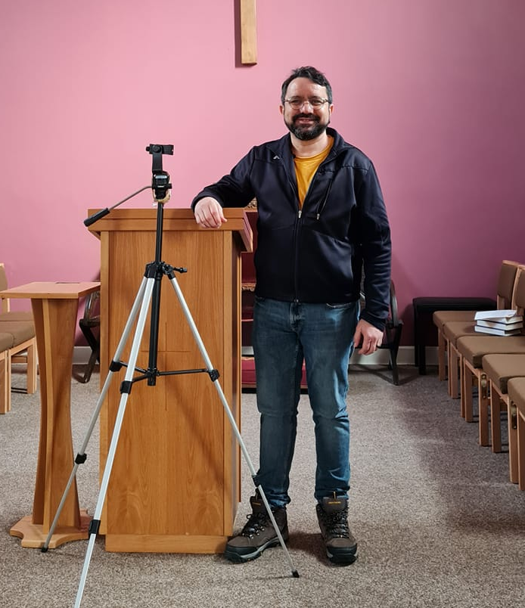
A MOVING ANONYMOUS POEM SIGNED DRUGS
I’ll ravish your body; I’ll control your mind.
I’ll own you completely, your soul will be mine.
The nightmares I’ll give you while lying in bed
The voices you’ll hear from inside your head.
The sweats, the shakes, the visions you’ll see,
I want you to know, these are all gifts from me.
But then it’s too late and you’ll know in your heart,
That you are mine and we shall not part.
You’ll regret that you tried me, they always do
But you came to me not I to you.
You knew this would happen, many times you were told.
But you challenged my power and chose to be bold.
You could have said no and just walked away
If you could live that day over, now what would you say?
You know I’ll be your master; you will be my slave,
I’ll even go with you when you go to your grave.
Now that you’ve met me, what will you do?
Will you try me or not? It’s all up to you.
I can bring you more misery than words can tell
Come take my hand, let me lead you to hell.
BRIDGES TO FREEDOM
Is a Christian recovery programme run in partnership with Bethany and the Tron. On Thursday afternoons here at Tron Moredun, Joe welcomes anyone who suffers from an addiction (alcohol, drugs, gambling sexual or other.) Starting at 2.00pm till 4.00pm with a break halfway. If you know of anyone needing help Joe’s no is 7458016976 or contact Cammy MacKenzie
FABIANO ZÉ SOARES
São Luis
Fabiano, our probationary minister arrived at the Tron on 9th May, leaving behind his wife Mareile, a Lutheran pastor, in Germany. She will join him once his training is finished and Covid allows. Born in Brazil on a small island called São Luis (about the size of Skye but with a population around one million.) Fabiano is well travelled. Kenya being one of his favourite places but it was during a holiday in 2018 in UK with Mareile that they both decided they wanted to make Scotland their home. Fabiano with a Masters degree in Cultural Theology and the knowledge that the Church of Scotland were keen to recruit applicants from overseas he soon got clearance to do his probationary year but it was much more difficult getting the visas in fact almost 18 months. We are so pleased that he eventually made it. He has settled in beautifully. Now just one of the Tron family. We especially love your informative morning reflections.
12
5

Slide 6

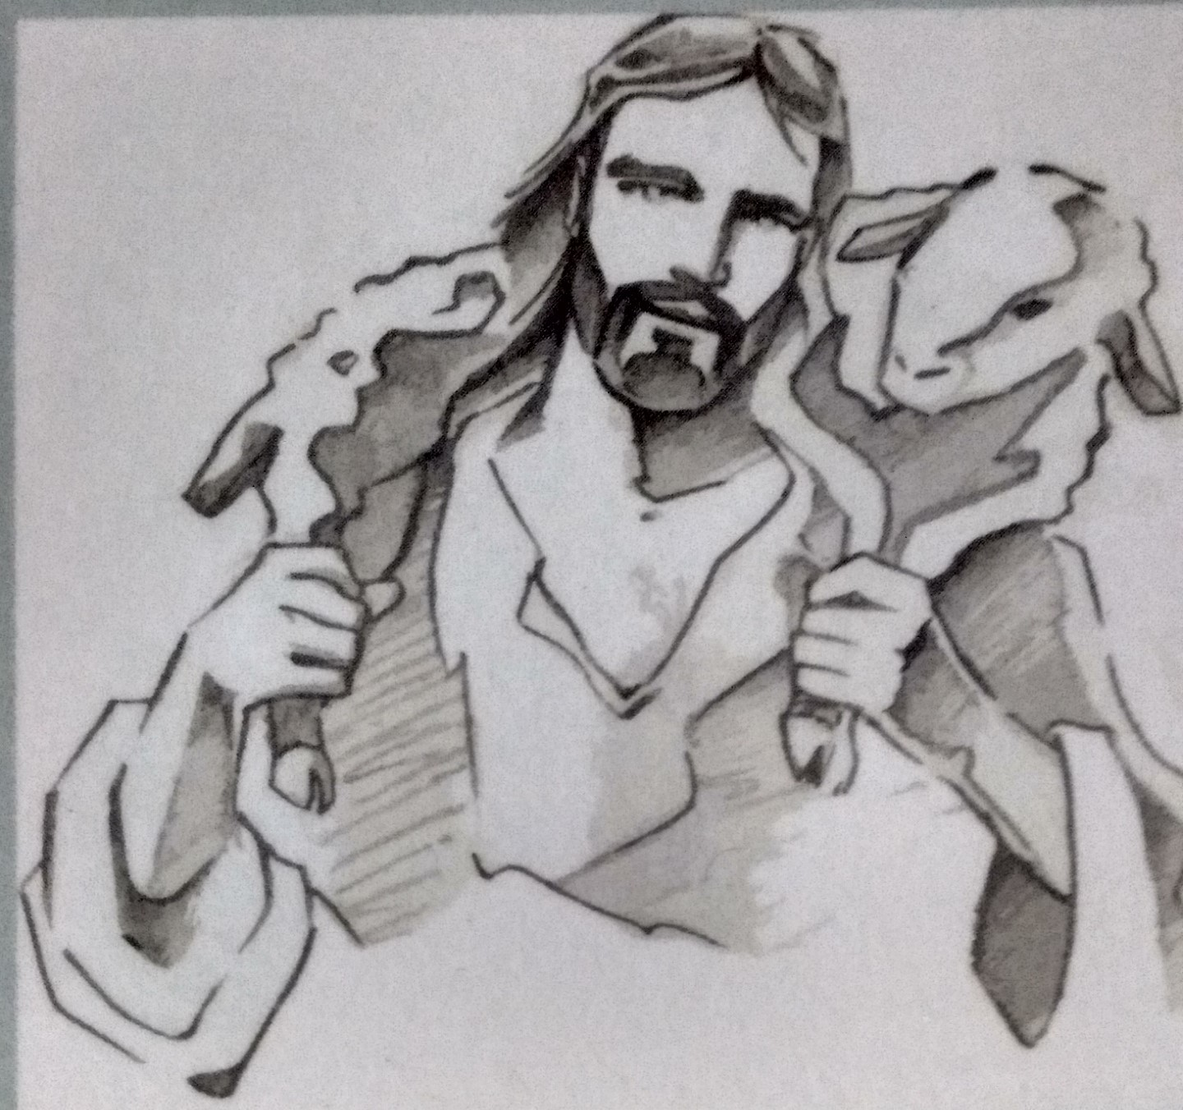
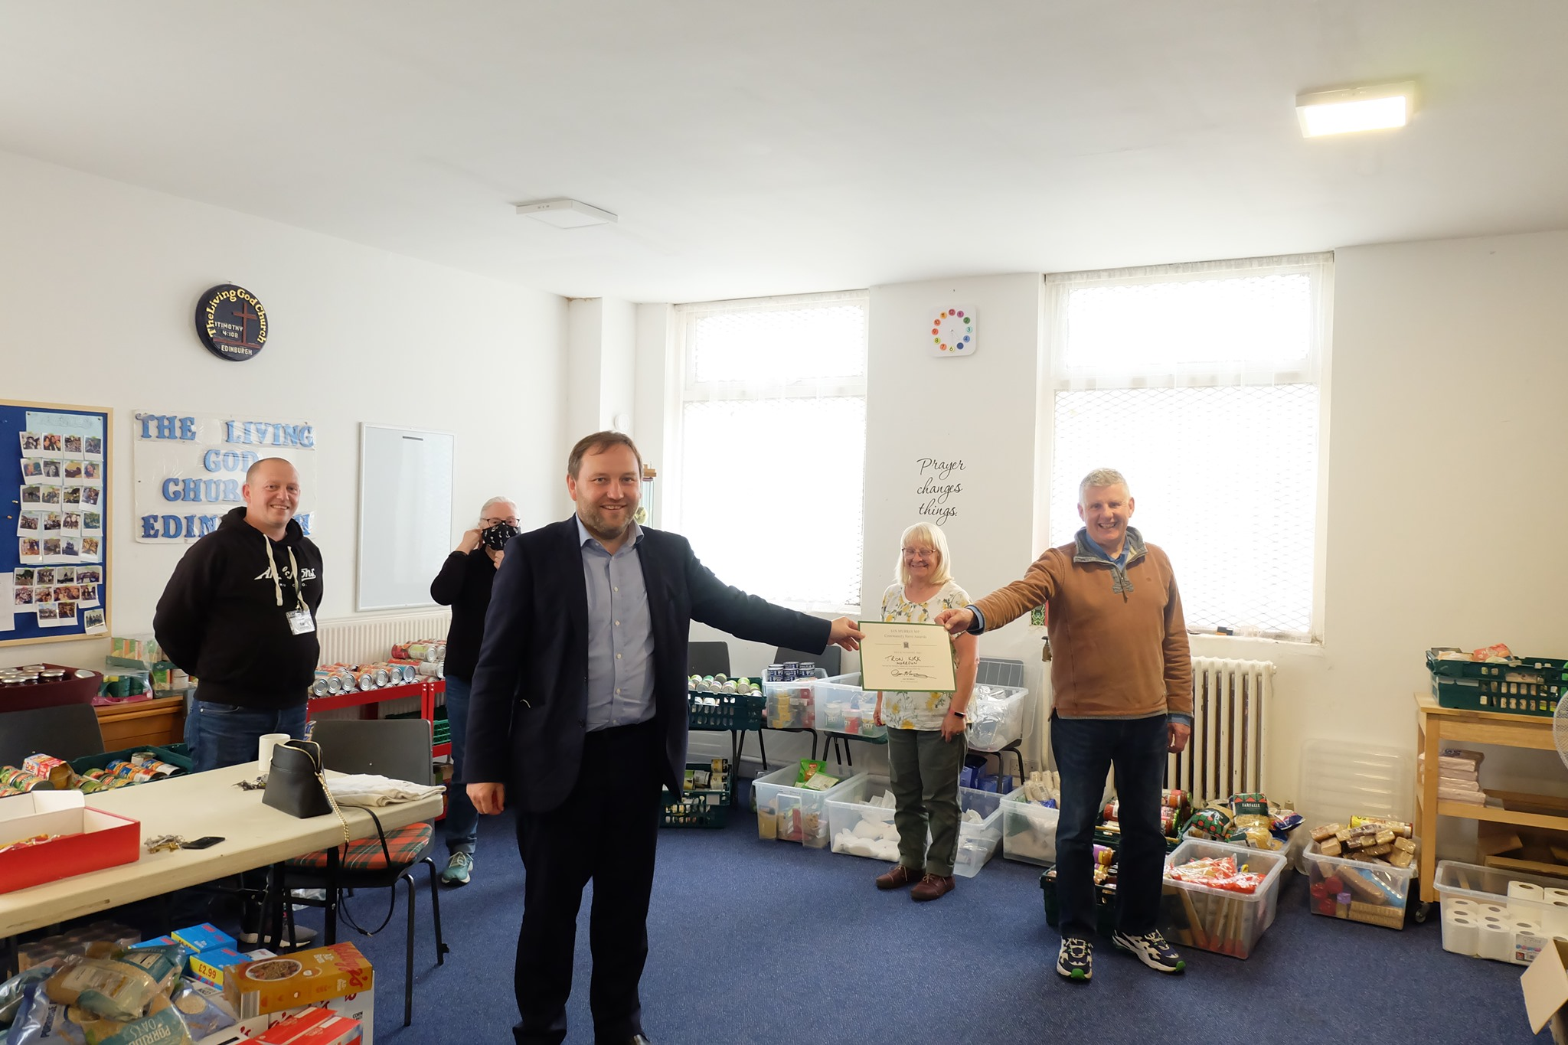
COMMUNITY HERO AWARD
Our very own Cammy MacKenzie was presented with a Covid Hero Award by Ian Murray, MP for Edinburgh South, for his fantastic work during the pandemic and lockdown. Cammy went above and beyond, giving out food to those in desperate need and helped out John Beatson while the Goodtrees Neighbourhood Centre was closed by using the Tron premises to store and pack Friday food bags. A mammoth task. Well done to all those involved.
Ivor Forrest our Pastoral Assistant at the Tron had his first book published in March 2020. He has always spoken of his great love for the 23rd Psalm. His book invites the reader to explore topics such as The condition of the Sheep, The character of the Sheep, The Chaos of Uncertainty, The Completeness of life in Christ, and finally The constant care of The loving Shepherd.
Consider our own lives – when we enjoy times of plenty and contrast it with the difficult uncertain times when we are going through barren and dry spells. Carried on His Shoulders will challenge you, inspire you, and bring hope to you and may even lift you up into a life fully satisfied by the provision and protection of The Good Shepherd.
Ivor’s book is dedicated to his loving wife Denise who encouraged him though out all the ups and downs.
It is well worth a read and is still available from Amazon. I have a signed 1st edition which you can borrow. Beth
6
11
Notes:
. Carried

Slide 7
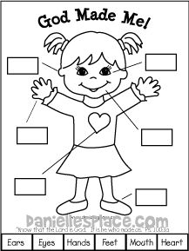
Fabiano
ACTIVITIES at TRON GILMERTON & MOREDUN
We are hoping to resume all in September if
the Covid 19 rules permit.
Monday:- Bible Study 12.30pm
Contact Janet McKenzie or come along
Tuesday:- Drop in Café. 2.00-4.00pm
at Goodtrees Neighbourhood Centre.
Wednesday:- Prayer Group 11.15-12.15pm
Community lunch 12.30pm
Thursday:- Bridges To Freedom 2.00-4.00pm
Contact Joe 7458016976
Badminton Club. 8.00-10.00pm
Contact Janice Gordon on 664 8773
Friday:- Food Bank 10.30-1pm
Rainbows 4.45-6.15pm
Brownies 5.15-6.15 pm
At Tron Kirk Gilmerton
Boys Brigade 6.30-9.00pm
Contact Liz Crocker on 332 0227
Children’s activities may have awaiting list.
Colour and fill in the boxes
10
7

Slide 8

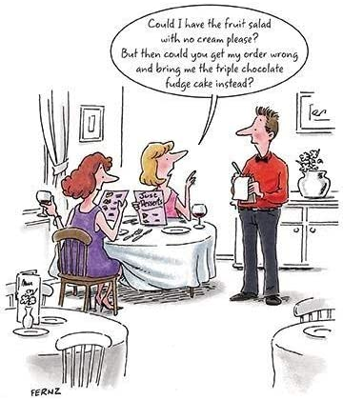
SU SCOTLAND
SURROUND THE CITY
Saturday 28th August 2pm-5.30pm (approx)
BADMINTON CLUB
If you would like a little exercise you can come along and join us on a Thursday night from 8 – 10pm. This is for anyone 18 years old and over. Come and have some fun.
Contact Janice on 664 8773 for start back dates.
Nine separate teams will be leaving from locations around the city, following pre-planned routes. By the end of the day, we'll have visited every school in Edinburgh! 18 months on from Covid halting SU schools ministry, this is an opportunity to highlight our continued desire to see a Christian witness in every school in Edinburgh. As part of the event Angus Moyes, es-team leader, will run around the whole city of Edinburgh – around 33 miles!
Join a walk team and pray for each school as you walk or help us reach our £5000 fundraising target by donating at the link below. Children and young people are very welcome to join a walk, but they must be accompanied by an adult if under 16.
We would love all ages to get involved so please get in touch if you would like to do part of a route.
Contact Melissa Gordon 07875861929
If walking is not your thing you can still be a part of this great venture by making a small donation to :-Justgiving.com/surround the city
Thankyou.
8
9

