Slide 1
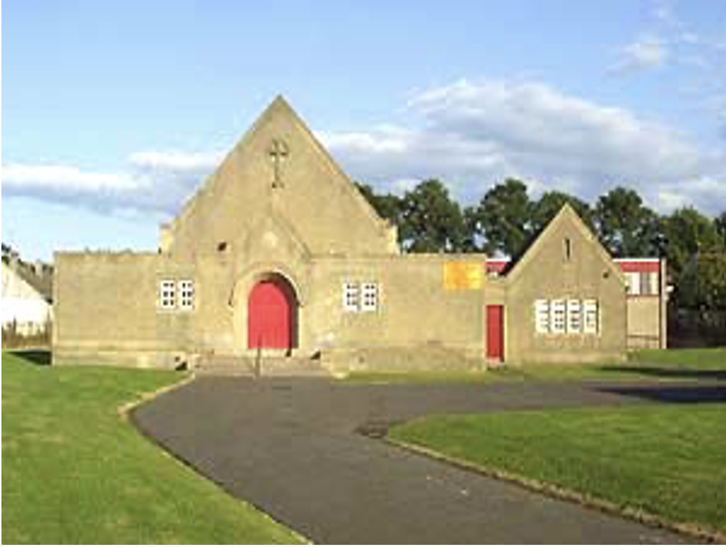
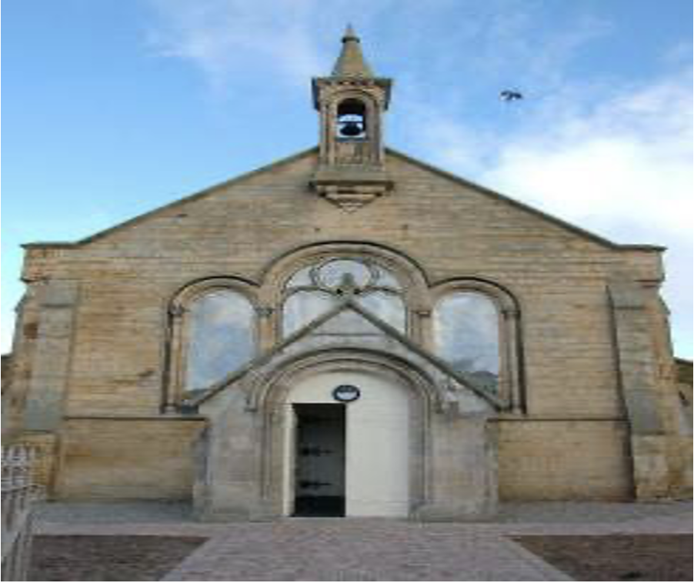
CHANGE OF ADDRESS
If you have moved house recently or are about to move, please fill in the address slip below and either hand it to your elder or post it to Alice Laing, 129 Upper Craigour, Edinburgh EH17 7SE
Thank you.
Name(s): ………………………………………..………………………………
OLD address: ……………………………….……………………..
………………………………………………………………………..
NEW address: ………………………………………..………………………………
................……………………………………………………………
NEW phone number: ……………………………………………………………….……….
Moving date: …………………………………………………..……………………
THE CHRONICLE
DECEMBER 2021
SUNDAY SERVICES
TRON KIRK MOREDUN 10.30am
TRON KIRK GILMERTON 5.00pm
MINISTER - REV CAMMY MACKENZIE
This chronicle was delivered by:
…………….………………………………………….……………...
Who can be contacted, if necessary, by telephone on:
………………………………………………………………………..
Tron Kirk Gilmerton and Moredun
Church of Scotland Edinburgh, Registered Charity SC009274
Magazine of the Tron Kirk Gilmerton and Moredun

Slide 2
LETTER FROM OUR MINISTER
Little six-year-old Harry was asked by his Sunday-school teacher:
"And, Harry, what are you going to give your darling little brother for Christmas this year?
"I dunno," said Harry; "I gave him the measles last year. “I will let you decide whether that makes you smile or not!
Hi everyone and welcome to our Christmas Newsletter. It has been a very fast year indeed and it hardly seems reasonable to me that the years do indeed pass by more and more quickly these days!
And what a year it has been. At the very least if you are reading this then like me YOU MADE IT for the good Lord knows many many poor souls did not make it and our hearts go out to families like mine after the death of my brother Jonny in May and countless others too. May the Lord bless all those who have lost loved one’s and in just a few days time we will hold our Blue Christmas service of thanksgiving and prayers for the ones we have loved and lost.
I really do find it heart warming that despite all that has happened we can still think of Christmas and the birth of the baby Jesus and our hearts can still be warmed by the very thought of Him giving up the comfort safety and perfection of heaven in order to come to the earth and live a perfect life and show us that Father God has a place in His heart for all of us. The very thought of him being born for us despite knowing how badly we would mess up and how regularly and often quite deliberately we would hurt each other never fails to amaze me even after 34 Christmases as a believer
The period of advent is upon us and can I please encourage you to set aside a few moments in preparation each day to celebrate the birth of God’s own son and to think about what you might want to ‘give him for Christmas. And just by way of a reminder……
It is our hearts He is interested in.
Since my very first Christmas until now my favourite Christmas Carol by Christina Rosetti still sums up Christmas the best….What shall I give Him poor as I am………I will Give my Heart.
God bless you this Christmas and always.
Cammy
USEFUL NAMES AND TELEPHONE NUMBERS
Cammy Mackenzie | Minister
Liz Crocker | Deacon
Janet McKenzie | Ordained Local Minister
Ivor Forrest | Pastoral Assistant
Sheila Bertram | Session Clerk
Alice Bertram Muriel Galbraith | Presbytery Elder Safeguarding Coordinator
Margaret Ballantyne | Organist
Alice Laing Denise Forrest | Roll Keeper, Session Clerk Social Convener Treasurer
Beth Ferrier Sheena Anderson | Messy Church Leader, Chronicle editor Sunday Teas, Life and Work
Pat Wilson Bill & Anna Cormack | Flower Convenor Chronicle Collators
2
15

Slide 3
TR0N NEWS
NEW BABY Congratulations to Eddie & Beth Ferrier on the birth of their great grand son Hamish William Fergus Pryde.
BIRTHDAYS
Belated birthday wishes to Beth Ferrier who celebrated her 80th birthday in September.
ACHIEVEMENTS
Glyn Evans was the 2021 winner of the first “MASTERS” A new tournament in the Dumbar Pool League. Massive Congratulations.
Muriel Galbraith’s grandson Sonny Holmes, at only 16years of age, won the Abercorn Senior Tennis Tournament, beating his coach. The No.1 seed. Well done Sonny…..a great achievement.
NEW MEMBERS
The congregation of the Tron Kirk Moredun welcomed three new members. Glynn Evan, Laura Crocker, Susan Speirs,
OUR VISITOR
The Moderator of the general assembly Rt. Hon. Lord Wallace of Tankerness QC conducted the service on 17th Oct. to a full congregation and afterwards had tea, cake & chat in the hall before being taken out for lunch at the Melville Inn. Bridget Shearer had the honour of taking her vows to join the Tron Kirk Congregation during the service The Bertram sisters were presented with long service certificates as elders for an amazing almost 100years. Alice 49 years and Sheila 48. An incredible achievement. The moderators wife and the others were presented with beautiful flower bouquets.
AdVANCED NOTICE FOR: A Week of Prayer for Christian Unity. 7TH January Short Service in St Barnabas 2.00pm
20th January Main Service – This will be on Zoom at 7.00pm
. .
14
14
A letter to Ministers, Session Clerks, Treasurers and Congregations,
On behalf of the Presbytery, I am writing to thank you and your Congregation for your financial generosity and hard work. Over these last eighteen months we have endured so many challenges in the life of our Church. No part of life was left untouched, each and every one of us isolated, cut off from others, forced to stay at home. It has been an exceptionally tough time, whatever our circumstances have been at home, and the normal struggles of life have been exacerbated by lockdown. My prayers continue with everyone who has found these months particularly burdensome.
Our faith gives us strength, the kind of strength that will help us endure and move onwards. We look forward and we hope, and we continue to pray for a better country and a better planet, more able to fight infection and disease, and that our scientists and our leaders will guide us through. We also continue to pray for a fairer society where the resources that we hold are shared generously and imaginatively.
I write to thank the Treasurers and Congregations across our city for the sterling work you continue to do on behalf of our Church, and for the good work that your generosity contributes towards and makes possible. Our Church survives only through the generosity of each one of us, however big or small the gifts we make.
The days ahead will continue to be challenging for all of us, particularly as we await the Presbytery Plan for the future shape of Church and ministries. On behalf of the Presbytery of Edinburgh, I would like to say a heartfelt thank you, and to assure you of my continuing prayers as we move forward together.
Yours sincerely,
Very Rev Dr Derek Browning
Moderator
The Presbytery of Edinburgh

Slide 4
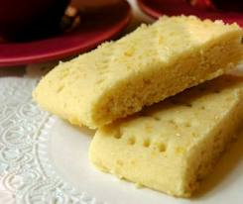
RECIPE CORNER
Alice B’s Christmas/New Year Shortbread
4 oz Plain flour
5 oz self raising flour
3oz cornflour
3 oz caster sugar
8 oz butter
Caster sugar to dredge
1. Set the oven at gas mark 2 (300F / 150 C
2. Melt the butter in a pan.
3. Mix all the other ingredients together, leaving a well in the centre, add melted butter last and mix with a wooden spoon until evenly mixed.
4. Place in a plain or fluted rectangular tin ( approx. 12ins by 8ins) press evenly over the surface pushing the mixture into all the corners of the tin, should be approx. 1cm thick. Prick all over with a fork, then bake on the middle shelf for 1hour 15mins when it should be lightly coloured.
5. Remove from the oven, sprinkle with the extra caster sugar, and while still hot cut into sections using a sharp pointed knife.
6. Cool on a baking tray, still in the tin. When completely cool and crisp gently ease the shortbread pieces out and store in an airtight tin.
CHRISTMAS SERVICES
Blue Christmas Service –Wed 8th Dec 7.00pm in the Tron Moredun
To remember loved ones who are no longer with us.
Christmas Eve 6.00pm –Tron Kirk Moredun
Christmas Eve 8.00pm – Tron Kirk Gilmerton
26th Dec. Normal Sunday Morning Service 10.30am
There will be no evening service in the Hub
HOME COMMUNION
You may be one of our more elderly or infirm members who are not now able to attend church and also miss out on our Sundays.
If you would like to receive Communion in your own home please contact the minister on 664 7538 or our Session Clerk, Sheila Bertram on 445 2129, or Alice Laing on 621 1170 who will be able to arrange this for you.
LENT STUDY GROUPS
These are due to begin on Ash Wednesday 2nd March for further details contact Kate Jackson or Clare Roller
LIFE and WORK MAGAZINE
If you would like a copy of the Church of Scotland Life & Work Magazine please speak to Sheena Anderson.
4
13

Slide 5
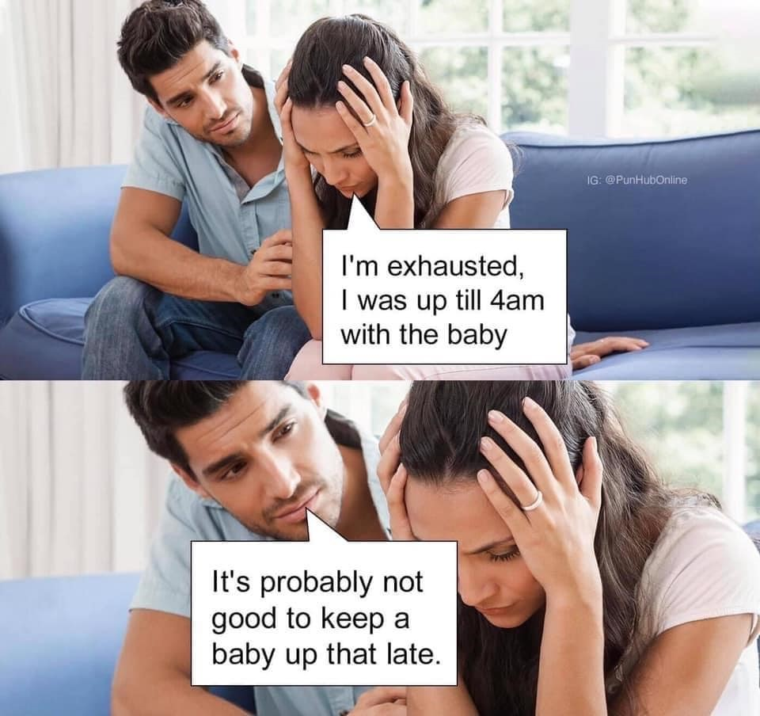
TAG
The unisex, all age, Thursday afternoon group have resumed their meetings using the large hall following the COVID guidelines. They have already undertaken an interesting programme including bingo, Edinburgh places Quiz, 80th birthday party, bring & buy sale, talk from Bob Henderson on “famous people” he has met, Fabiano’s life before the Tron and a craft day helping Val with the poinsettias and holly for her wonderful Christmas decoration of the cross. The committee are so well organized that even the Christmas Dinner at The Robin’s Nest is already booked.
The meetings are fortnightly at 2.00pm cost £1.00 including tea/coffee & biscuits. It really is a friendly group with lots of laughs & chat. ALL WELCOME.
BADMINTON CLUB
If you would like a little exercise you can come along and join us on a Thursday night from 8 – 10pm. This is for anyone 18 years old and over. Come and have some fun. Contact Janice on 664 8773
THE CHRISTMAS FAYRE
The Christmas fayre raised the incredible sum of:- £1,050. Our grateful thanks to all who worked tirelessly to stock, donate, and sell on the day. Thanks also to all who came on the day to spend their hard earned cash at our main fundraising event of the year.
A Senior’s Version of FACEBOOK
For those of my generation who do not, and cannot comprehend why Facebook exists: I am trying to make friends outside of Facebook while applying the same principles. Therefore every day I walk down the street and tell passers-by what I have eaten, how I feel at the moment, what I have done the night before, what I will do later and with whom. I give them pictures of my family, my dog and of me gardening, taking things apart in the garage, watering the lawn, standing in front of landmarks, driving around town, having lunch, and doing what anyone and everyone does every day. I also listen to their conversations, give them “thumbs up” and tell them I ” like” them. And it works just like Facebook. I already have 4 people following me:
2 police officers, a private investigator and a psychiatrist.
12
5

Slide 6
Every day the planet burns a little more
We only have a short while
So quick, let me tell you
We’re too far gone to turn this around
I can’t believe
We have it in us to put this right
It is all too late, too late
How can you say
But do not give up hope
Every day the planet burns a little more
And hot air rises
While governments pump out empty promises
We are powerless
Don’t be foolish to imagine that
Together we have a voice
Big enough to change the world
The decisions we make each day are
Unimportant
The food we eat, the things we buy, how we get around
How naïve to think
The destruction of centuries could be undone
In a few decades
If we could just find reverse.
( NOW READ THIS POEM FROM BOTTOM TO TOP)
Brian Bilston
News from Joanna Manners
It was lovely to be at the Tron Christmas Fair on the 20th and to meet up with some of you again and I’m delighted that Beth has asked for a little update on my work.
The Wee World Café has started back up again in person on a Monday evening. It’s great to be able to meet students face to face and share a cup of tea or coffee together. Each week we discuss a different topic, such as, Edinburgh, Hobbies, or celebrations. The numbers have been up and down but we have a few regulars, including 2 Chinese guys who have really benefited from the chance to practice English and are growing in confidence in speaking and listening.
Local Link is our hospitality programme where we link up international students with local individuals and families. It’s a great opportunity for students to meet local people and make friends. Its really encouraging that we currently have 20 students linked up with locals and good relationships being built. One student said that it was so lovely to be in a home and experience British culture. Thanks for your continued support and prayers, I really appreciate it.
Living simply
Lord may we who have plenty live simply
So that others may simply live.
HUNGER & JUSTICE
O God, to those who have hunger, give bread, and to us who
have bread, give the hunger for justice.
6
11
Notes:
. Carried

Slide 7
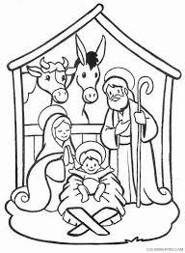
ACTIVITIES at TRON GILMERTON & MOREDUN
Monday:- Bible Study 2.15pm
Contact Janet McKenzie or come along
Wednesday:- Prayer Group 11.15-12.15pm
Community lunch 12.30pm
Thursday:- TAG 2.00pm (Fortnightly)
Bridges To Freedom
Contact Joe 7458016976 or Cammy
Badminton Club. 8.00-10.00pm
Contact Janice Gordon on 664 8773
Friday:- Food Bank 10.30-1pm
Rainbows 4.45-6.15pm
Brownies 5.15-6.15 pm
At Tron Kirk Gilmerton
Boys Brigade 6.30-9.00pm
Contact Liz Crocker on 332 0227
Children’s activities may have awaiting list.
Saturday:- Messy Church 4.00pm- 6.00pm
The intension is to start back the
first Saturday in February.
Colour for Christmas
10
7

Slide 8
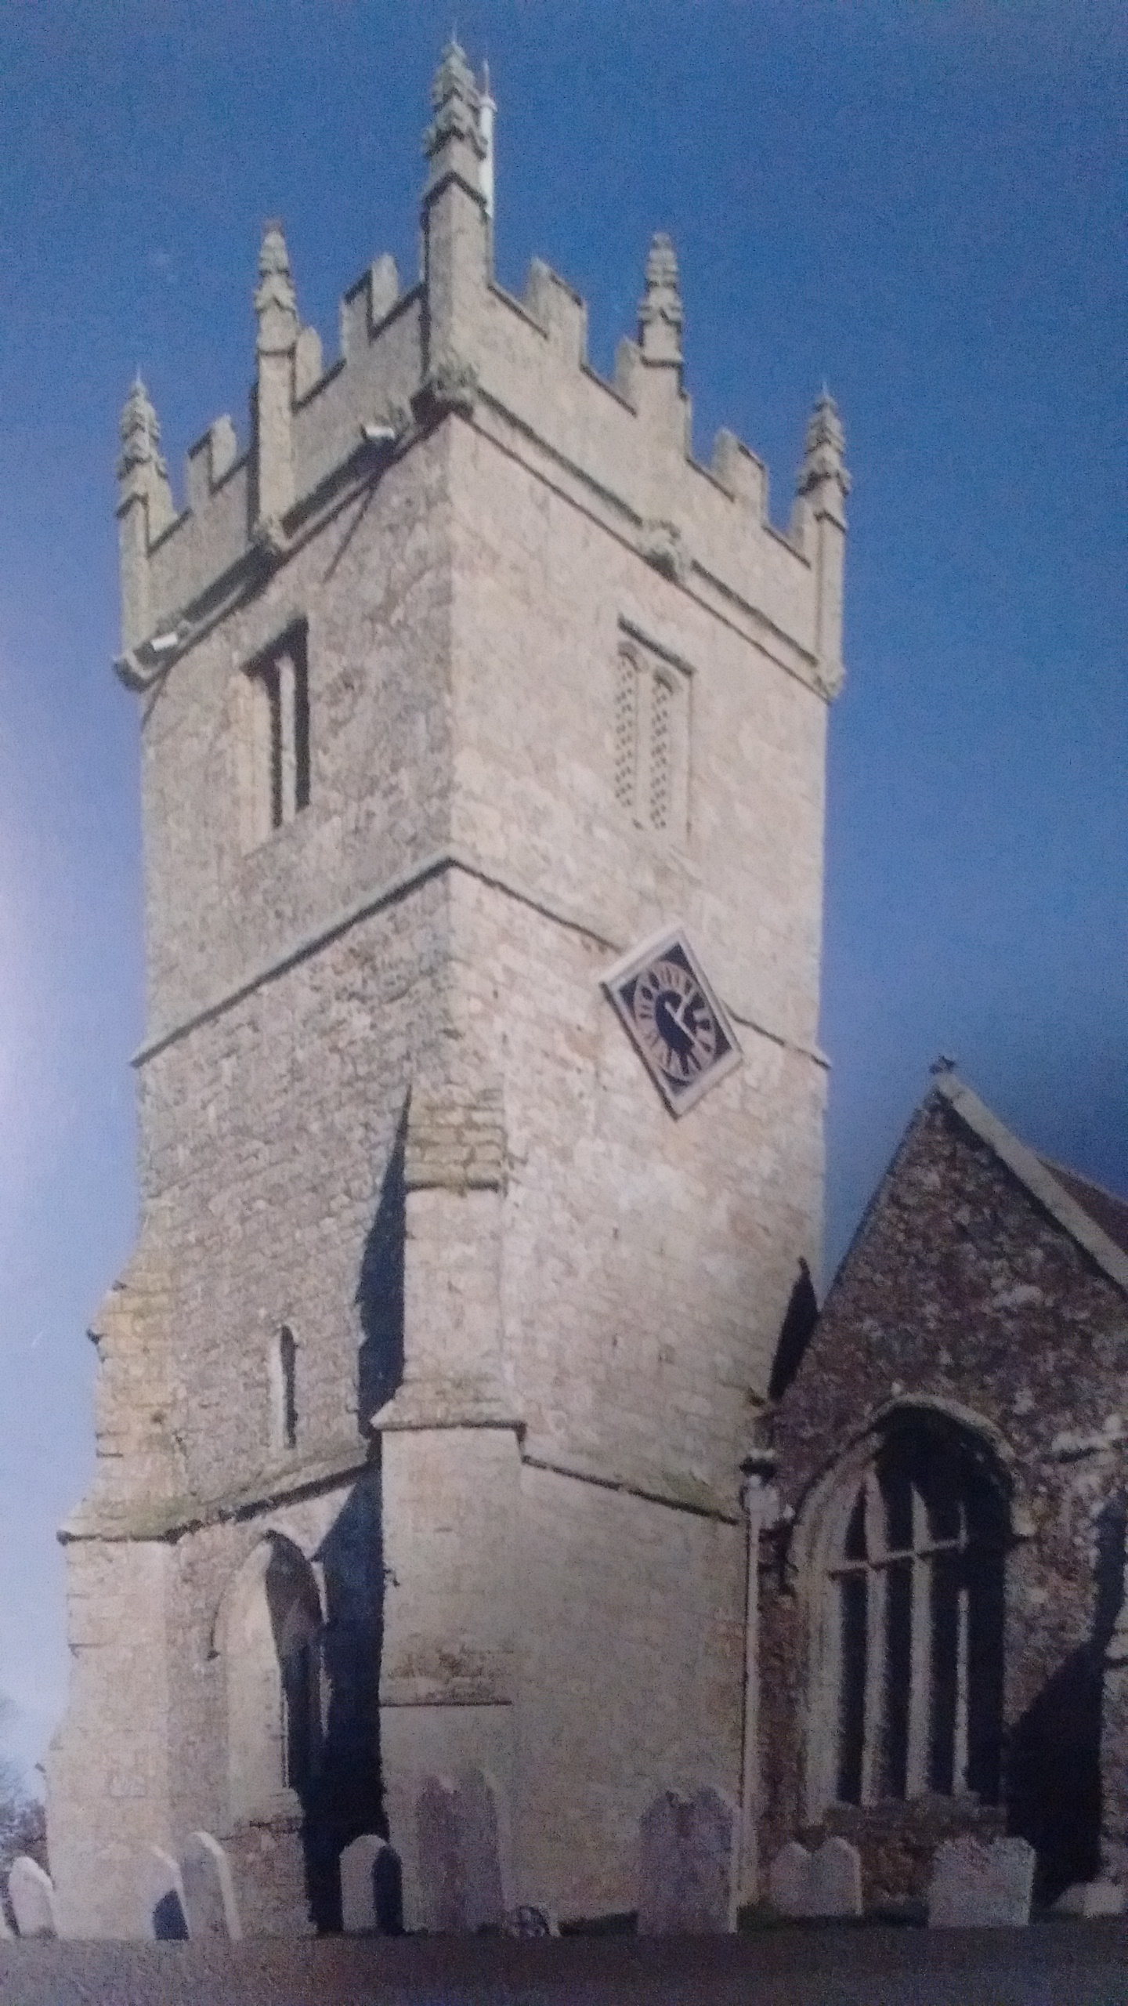
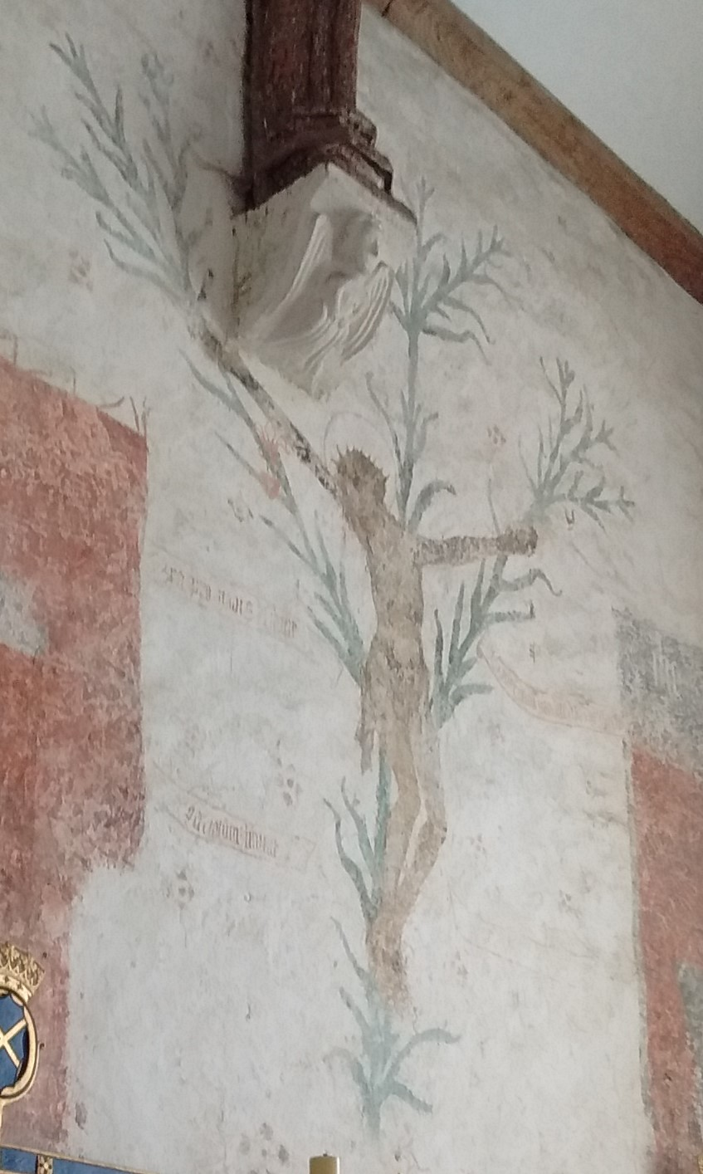
GODSHILL CHURCH
The church of the Lily Cross
2022 IS OUR 70TH ANNIVERSARY
On 28th Sept. 1952 the Tron Kirk was officially opened. It was built as a Community Hall Church to serve the new housing estate of Moredun. This allowed for a proper stage with curtains at the opposite end from the chancel. It was well used & hosted many acts & performances from all the different church organisations as well as many guest shows. In the 70s even Billy Connelly appeared with his folk rock band The Humblebums We had a large adult choir lead by the organist Miss Murray and a junior choir who also performed Kinderspiels on stage such as the “Dragon of tangle mountain” The yearly Youth Club Gang Show was always a sell out at all of it’s performances. The second half of the programme usually featured a musical e.g. Salad Days, The Pyjama Game, South Pacific, Oklahoma, West Side Story. Back in these days the church also had its own football team in the Churches League called Fernieside Star. The main hall housed the Sale of Work, Christmas parties, Country dancing club, Social dances, and many other activities, whilst the organisations had to make do with the tin hut in the grounds. Very cold in winter. The Men's Club was also outside in a brick hut.
Eventually a new extension The Ian Ireland Memorial Hall was opened to accommodate the growing congregation. A new era had arrived. A modern all electric kitchen….the old pocky one became the Minister’s study once the hatch had been built up. A Thursday evening badminton club immediately organised in the new hall and still runs to this day. The new lesser hall was in constant use and could be partitioned into two rooms if required. The organisations came in from the cold and expanded.
The purpose of this “down memory lane” is to inspire you for ideas for our 70th Anniversary celebrations. All suggestions will be considered.
Legend has it that when Christian missionaries had won converts to the faith, they began to build a church on a level place about a mile to the south of the present village. On three successive occasions at night, the stones were removed to the site of the present church. After the first two occasions the builders restarted building the following morning on the site they had chosen, but after the third time they recognised that this miraculous removing of the stones indicted that the present site was the one God intended for His church, so there they built it.
Hence Godshill, the hill God chose for his church.
It is popularly know as “The Church of the Lily Cross” because of the unique mural on the east wall of the south transept. This shows a large figure of Our Lord crucified on a triple-branched flowering lily, the Lily Cross, symbolic of the purity and sinlessness of his Virgin Mother. It is unique, for there is no other like it in the British Isles. A few such murals may be found on the Continent, and there are a number of stained-glass windows with the Lily Cross theme in this country.
8
9

